Slide 1
Enabling Speculative Parallelization via Merge Semantics in STMs
Kaushik Ravichandran (kaushikr@gatech.edu)
Santosh Pande (santosh@cc.gatech.edu)
College of Computing
Georgia Institute of Technology

Slide 2
Outline
Introduction
Connected Components Problem and Speculative Parallelization
STMs and the Merge Construct
Evaluation
Conclusion

Slide 3
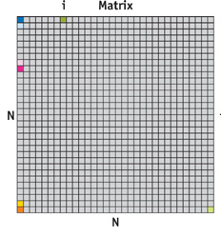
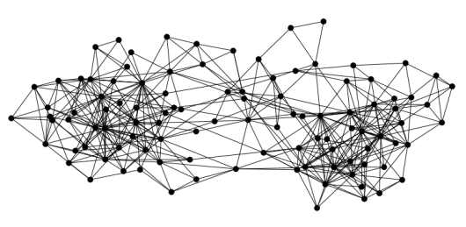
Parallelism in Applications
Regular Parallel Applications
Irregular Parallel Applications
HPC Applications
Dense Matrix Computations
Simulations
…
Large Amount of Parallelism
Easily parallelized
Pointer Based Applications
Graphs, Trees
Linked Lists
…
Significant Amount of Parallelism available
Difficult to parallelize

Slide 4
Irregular Parallelism
Parallelism depends on runtime values
Pointer based which makes it difficult to statically parallelize
Non-overlapping sections can be processed in parallel
Speculation coupled with optimistic execution allows parallelization
Examples: applications with disconnected sparse graphs

Slide 5
Outline
Introduction
Connected Components Problem and Speculative Parallelization
STMs and the Merge Construct
Evaluation
Conclusion

Slide 6
Connected Components Problem (CCP)
Applications:
Video Processing
Image Retrieval
Island Discovery in ODE (Open Dynamic Engine)
Object Recognition
Many more…

Slide 7
Connected Components Problem (CCP)
1
1
2
1
2
2
1
2
1
1
2

Slide 8
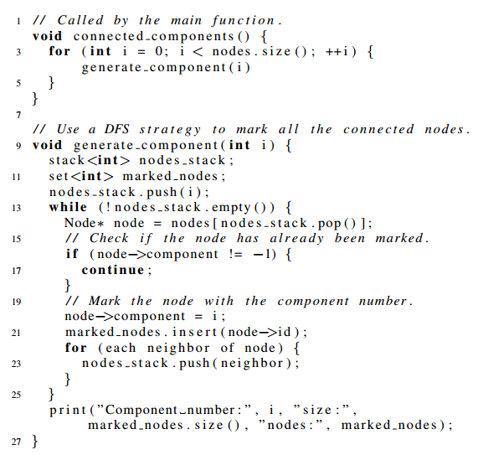
Serial Solution
1
1
1
1
1
1
Pseudo-code (DFS Strategy)
insert node into nodes_stack
for each node in nodes_stack:
if node is marked continue
mark node
insert node into marked_nodes
for each neighbor of node:
insert neighbor into nodes_stack
2
2
2
2
Each iteration of loop depends on previous iteration
2

Slide 9
Speculative Parallelization

Slide 10
Speculative Parallelization
Serial Thread

Slide 11
Speculative Parallelization

Slide 12
Speculative Parallelization

Slide 13
Speculative Parallelization
1
1
2
1
2
2
1
2
1
1
2
Parallelized Computation

Slide 14
Speculative Parallelization
Wrong Speculation

Slide 15
Speculative Parallelization
1
2
2
1
1
2
Wrong Speculation

Slide 16
Speculative Parallelization
Serial Thread Wrapped in STM
STMs provide “atomic “ construct and take care of conflicts by rolling back one thread

Slide 17
Speculative Parallelization
Serial Thread Wrapped in STM

Slide 18
Speculative Parallelization
Serial Thread Wrapped in STM

Slide 19
Speculative Parallelization
1
1
2
1
2
2
1
2
1
1
2
Serial Thread Wrapped in STM
Sort of Data Parallelism over an Irregular Data Structure
Can we do better?

Slide 20
Outline
Introduction
Connected Components Problem and Speculative Parallelization
STMs and the Merge Construct
Evaluation
Conclusion

Slide 21
Software Transactional Memory (STMs)
STMs optimistically execute code and provide atomicity and isolation
Monitor for conflicts at runtime and perform rollbacks on conflicts
Can be used for speculative computation but not designed for them
Main STM Overheads:
Logging
Rollback after conflict

Slide 22
Software Transactional Memory (STMs)
STMs optimistically execute code and provide atomicity and isolation
Monitor for conflicts at runtime and perform rollbacks on conflicts
Can be used for speculative computation but not designed for them
Main Overheads:
Logging
Rollback after conflict
Inherent cost of rollback
Cost of lost work
Do we have to discard all the work?
Checkpointing state (Safe compiler-driven transaction checkpointing and recovery, OOPSLA ‘12, Jaswanth Sreeram, Santosh Pande)
Can we try merging the state from the aborting transaction?

Slide 23
Merge Construct
STMs discard work from transaction
Can we salvage the work that it has done?
Can try to merge what it has processed with other transaction

Slide 24
Merge Construct
STMs discard work from transaction
Can we salvage the work that it has done?
Can try to merge what it has processed with other transaction
0101101101110001101010
110101101100111

Slide 25
Merge Construct
STMs discard work from transaction
Can we salvage the work that it has done?
Can try to merge what it has processed with other transaction
0101101101110001101010
110101101100111
01010101011100111010101010
Application dependent

Slide 26
Merge for CCP
Conceptually Simple
t1
t2
nodes_stack
marked_nodes
nodes_stack
marked_nodes
A transaction conflicts only because it was working on the same component
Before a transaction is discarded take its nodes_stack and marked_nodes list and add it to the continuing transaction
Call this MERGE function after a conflict
(t1: continuing transaction, t2: aborting transaction)

Slide 27
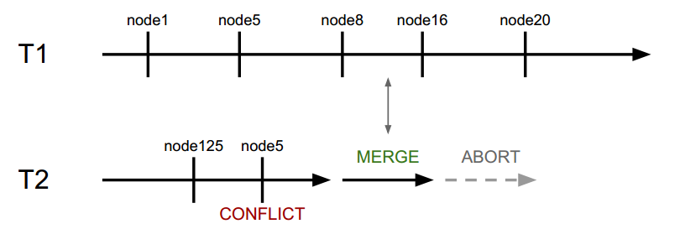
Merge for CCP
We need deal with two main issues:
Consistency of Data Structures in T2 (Aborting Transaction)
Safety of updates for Data Structures in T1 (Continuing Transaction)
We use two user-defined functions MERGE and UPDATE
(t1: continuing transaction, t2: aborting transaction)

Slide 28
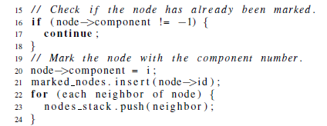
Data Structures in T2
When can T2 abort?
Can abort only when it read/writes to shared state
A
B
When can T2 abort?
Can abort only when it read/writes to shared state (A or B)
Are it’s data structures nodes_stack and marked_nodes safe to use in the merge function?

Slide 29
Data Structures in T2
A
B
Irrespective of conflict at A or B
Both Data structures nodes_stack and marked_nodes either have node or do not have it
(t1: continuing transaction, t2: aborting transaction)
Valid State of Data Structures

Slide 30
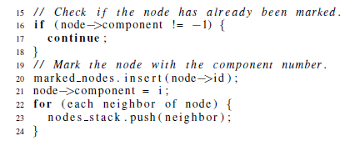
Data Structures in T2
A
B
Switch around lines 20 and 21
A
B

Slide 31
Data Structures in T2
A
B
If conflict at B
marked_nodes has node while nodes_stack does not have it neighbors
(t1: continuing transaction, t2: aborting transaction)
Invalid State of Data Structures

Slide 32
Detecting Invalid or Valid States
Step 1: Identify Conflict Points
Easy step since STMs typically wrap these instructions in special calls
Step 2: Identify Possibility of an Invalid State
At each of the points from Step 1 check if the MERGE function has a set of valid data structures as described in previous slides.
If valid, then nothing needs to be done
If cannot be determined easily or invalid use SNAPSHOT API
SNAPSHOT API:
Call to API made by programmer at a point in code (typically start/end of loop)
Make a copy of the data structures
Use only this copy in MERGE function
Example coming up

Slide 33
Data Structures in T1
T1 still executing when T2 is aborting (performing MERGE)
Provide MERGE specific data structures:
merged_nodes_stack and merged_marked_nodes for use in MERGE

Slide 34
Data Structures in T1
Now the information needs to be incorporated back into the main data structures
Programmer defines UPDATE function
Indicates safe points to invoke UPDATE using SAFE_UPDATE_POINT() call

Slide 35
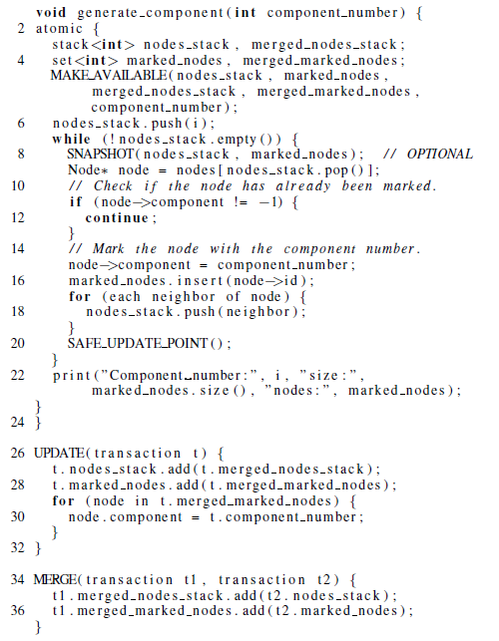
Putting It All Together

Slide 36
Outline
Introduction
Connected Components Problem and Speculative Parallelization
STMs and the Merge Construct
Evaluation
Conclusion

Slide 37
Experimental Evaluation
Minimum Spanning Tree (MST) Benchmark
Connected Components Benchmark
Configuration:
Dual quad-core Intel Xeon E5540 (2.53GHz)
GCC 4.4.5 with –O3 on Ubuntu 10.10
OpenMP used to parallelize the code
TinySTM 1.0.0 (ETL)

Slide 38
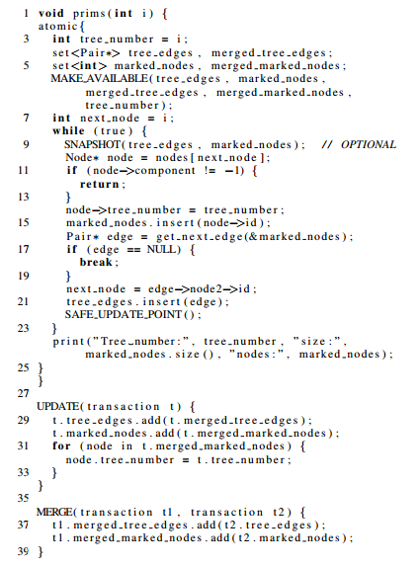
Minimum Spanning Tree (MST)
Pseudo-code
while node do:
if node is marked return
mark node with tree number
insert node into marked_nodes
find the next edge from the marked_nodes frontier else returns
add this edge to tree_edges
node = this edge’s unmarked node

Slide 39
MST Benchmark
Results with 4 different configurations
Serial Implementation (No parallelism and No STM overheads)
STM based Parallelization
STM based Parallelization with Merge
STM based Parallelization with Merge and Snapshot
Results from 4 different datasets
DS1 (6000 nodes): X = 6000, T = 6, N = 6.
DS2 (9000 nodes): X = 9000, T = 5, N = 6.
DS3 (12000 nodes): X = 12000, T = 4, N = 8.
DS4 (16000 nodes): X = 16000, T = 3, N = 8.
Randomly generated parameterized graphs

Slide 40
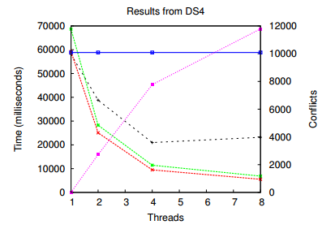
MST Results
Parallelization using simple STM based speculation gives performance improvement when compared to the serial implementation
Performance using simple STM based speculation drops after 4 threads (due to higher contention)
STM Parallelization with Merge outperforms other implementations and scales
Snapshot adds slight overhead but still demonstrates good scalability

Slide 41
MST Results
STM Parallelization with Merge scales well
Snapshot-ing shows overheads but still scales well
At 8 threads 90% faster than serial
Actually demonstrates super linear speedups

Slide 42
Conclusion
Speculation is needed to deal with Irregular Parallelism
STMs can be used for speculation but are not designed for it
The merge construct provides explicit support for speculation by reducing the overheads of mis-speculation
We deal with issues of consistency and safety of data structures during the merge
We demonstrate good scalability when compared to regular STM based speculation by reducing overheads of mis-speculation

Slide 43
Thank you!
Q & A
Looking for applications, suggestions welcome
Code shortly available at: http://sourceforge.net/projects/mergestm
Contact at: kaushikr@gatech.edu

